Slide 1
The Battle of the neighborhoods

Slide 2
Warsaw
Warsaw is the capital and the largest city of Poland. It is located in the center of the country, which makes it easily accessible from the other parts of Poland. The city's agglomeration is highly populated due to its economic potential and the best job opportunities (the average salary in Warsaw is higher than anywhere in the country). Rich and diverse educational offer attracts people from all over the world.

Slide 3
Problem description
Moving to Warsaw is the most common direction of migration in Poland, many people search of a good house prices and good rating schools for their childrens. This project focuses on analyzing the features of neighborhoods and comparative analysis between them. The features include mean price per squared meter, school rating and occurring venues.
The aim of this project is to help choose the most suitable neighborhood and to get awerness of the place before moving in.

Slide 4
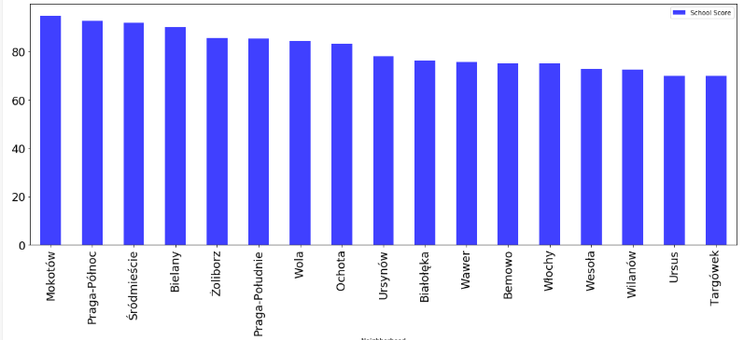
School ratings

Slide 5
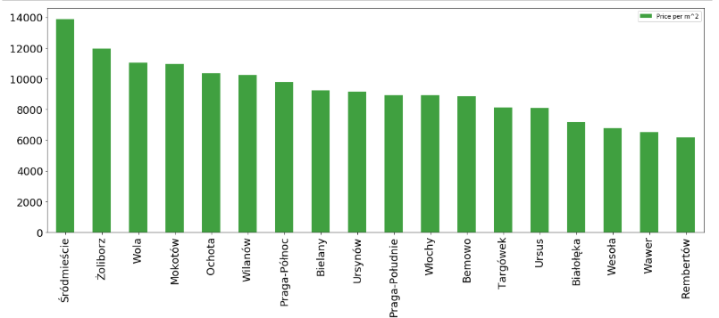
House prices

Slide 6
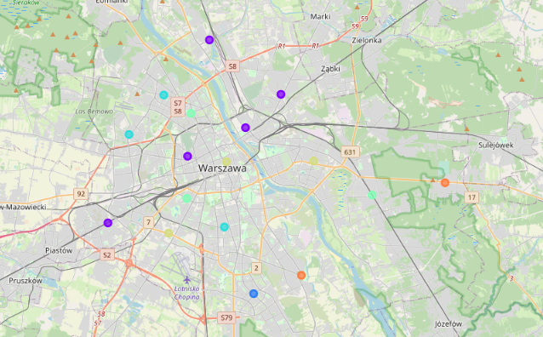
Map of clusters

Slide 7
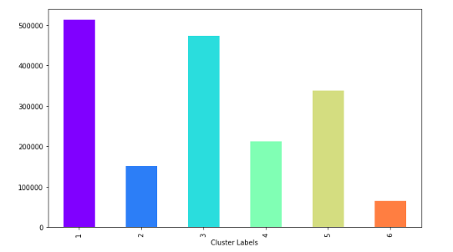
Population in each cluster

Slide 8
Conclusion
In this project, through a K-means cluster algorithm we separate the neighborhood into 6 clusters. Using the charts above decision leading to a particular neighborhood based on average house prices and school rating can be made

